Slide 1

Department Of Computer Science

Slide 2
Software Design Document Project Title (Valid Title, reflecting scope and objectives)
Student 1 Name
Student 1 Registration Number.
Student 2 Name
Student 2 Registration Number.
Supervisor:
Supervisor Name
Co-Supervisor (if any):
Co-Supervisor Name
Department Of Computer Science
Submission Date: Day-Month-Year

Slide 3
Project Category
Note: 1 Slide only
Based on your project type, write the appropriate Category / Categories of your project.
A- Desktop Application/Information System
B- Web Application/Web Application based Information System
C- Problem Solving and Artificial Intelligence
D- Simulation and Modeling
E- Smartphone Application
F- Smartphone Game
G- Networks
H- Image Processing
I- Other (specify category) ______________________

Slide 4
Research Based Project
Note: 1 Slide only
Based on your proposed project type, mention Yes, if reading research papers is a major component of your project otherwise mention NO.
Incase you have mentioned Yes, mention at least 5 papers details that you will thoroughly read and understand for your project implementation.

Slide 5
Introduction
Note: 1 Slide only
Based on your proposed project type, specify the purpose of your project.
Mention the key goals of selecting the project.
Provide the local, international and professional impact.

Slide 6
Tools and Technologies
Note: 1 - 2 Slides
Based on your proposed project type, mention all the hardware/software tools and technologies with version number which will be used in implementation of the project. Write about the APIs, language(s), SDK(s) etc. which you will use for implementation. You should have strong reasons for choosing these tool and technologies
Tools And Technologies | Tools | Version | Rationale
 | MS Visual Studio | 2015 | IDE
 | MS SQL Server | 2015 | DBMS
 | Adobe Photoshop | CSC 6 | Design Work
 | MS Word | 2015 | Documentation
 | MS Power Point | 2015 | Presentation
 | Pencil | 2.0.5 | Mockups Creation
 | Technology | Version | Rationale
 | C# | 6.0 | Programming language
 | SQL | 2013 | Query Language
 | Html | 5 | Web Development

Slide 7
Scope
Note: 1 Slide Only
Based on your proposed project type, Write down the scope of your project in logical flow with consistency.
Briefly define the major functionalities of the proposed project.
Use appropriate terms of Software Design, Development and Engineering

Slide 8
Modules
Note: 1-2 Slides
Note: Usually atleast 5-6 Modules for 2 student’s projects and 8-9 modules for 3 student’s project
Based on your proposed project type, Only List down the modules of the proposed project in this slide
Module 1: Module-1 Name
Module 2: Module-2 Name
Module 3: Module-3 Name
Module 4: Module-3 Name
Module 5: Module-5 Name
Module 6: Module-6 Name

Slide 9
Software Process Methodology
Note: 1 Slide Only
Based on your proposed project type, discuss and justify the choice of process methodology being followed. (E.g. Incremental, Spiral, Agile etc) with advantages (1-slide)

Slide 10
Software Design Methodology
Note: 1 Slide Only
Based on your proposed project type, discuss and justify the choice of design methodology being followed. (OOP or Procedural) with advantages (1-slide)

Slide 11
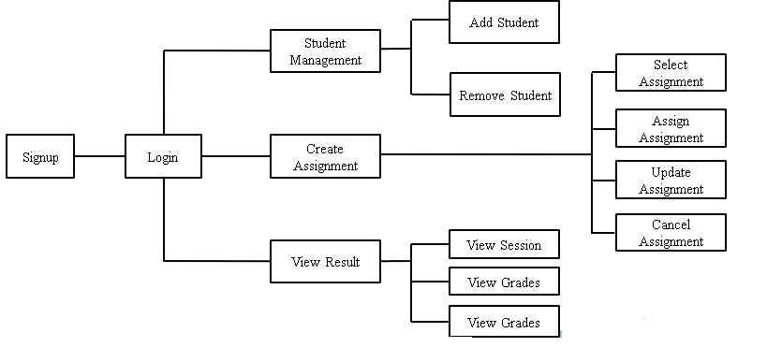
Process Flow Diagram of Proposed Project
Note: 1 Slide
Show the process flow diagram of your system with labels. For Example:
Figure-1: Process Flow Diagram – System Interaction For Professor.

Slide 12
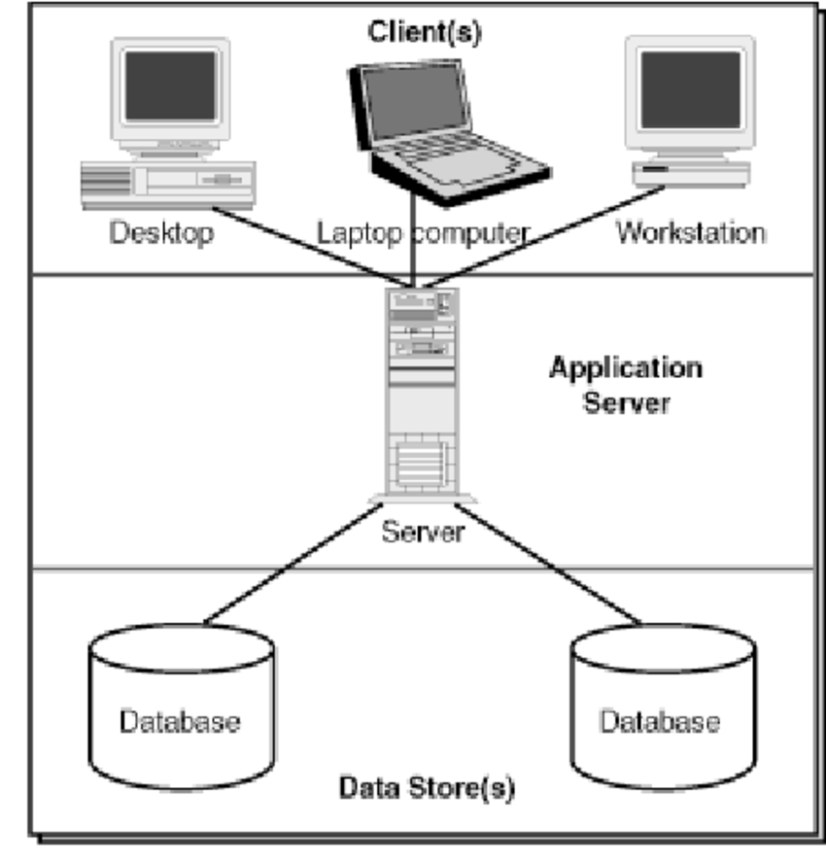
Architecture Diagram of Proposed Project
Note: 1 Slide
Show the Architecture diagram of your system with labels. For Example:
Figure-2: Client-Server Architecture Diagram

Slide 13
Use Case Diagram
Note: 1 Slide/Per Diagram (Usually 2-5 Slides)
Insert Use Case Diagrams as per Actors wise and with proper labeling and caption.
Usually (2- diagrams)
Create Use Case Diagram Using MS VISIO (or any other standard UML supported Tool) as per UML standard notations.
Note: Make sure that diagrams are properly labelled, clear, readable and visible.

Slide 14
Activity Diagrams
Note: 1 Slide/Per Diagram (Usually 2-3 Slides) -
Based on your project type, discuss the activity diagrams (atleast 4 diagrams).
Create Activity Diagrams Using MS VISIO (or any other standard UML supported Tool) as per UML standard notations.
Note: Make sure that diagrams are properly labelled, clear, readable and visible.

Slide 15
Data Representation [ERD, XML schema,JSON Schema ]
Note: 1 Slide/Per Diagram (Usually 1-2 Slides) -
Based on your project type, discuss, in case you are using a database, create an ERD for it.
Create ERD Diagram Using MS VISIO (or any other standard UML supported Tool) as per UML standard notations.
In case you are not using a database, present which ever format you are using to represent the data of your system such as XML Schema, JSON Schema etc.
Usually (2- diagrams maximum)
Note: Make sure that diagrams are properly labelled, clear, readable and visible.

Slide 16
Class Diagram or Data Flow Diagrams
Note: 1 Slide/Per Diagram (Usually 1-2 Slides) -
Based on your project type, discuss the class diagram or Data Flow Diagram.
In case of DFD, discuss level 0, 1 and 2
Create Diagram Using MS VISIO (or any other standard UML supported Tool) as per UML standard notations.
Note: Make sure that diagrams are properly labelled, clear, readable and visible.

Slide 17
Sequence Diagram
Note: 1 Slide/Per Diagram (Usually 2-3 Slides) -
Based on your project type, discuss the sequence diagrams (atleast 4 diagrams) in 2-3 slides
Create Sequence Diagrams Using MS VISIO (or any other standard UML supported Tool) as per UML standard notations.
Note: Make sure that diagrams are properly labelled, clear, readable and visible.

Slide 18
Schematic Diagram (Only for Hardware Projects)
Note: 1 Slide/Per Diagram (Usually 1-2 Slides) -
Based on your project type, discuss the Schematic diagram in 1-2 slide.
Create Schematic Diagram Using MS VISIO (or any other standard UML supported Tool) as per UML standard notations.
Note: Make sure that diagrams are properly labelled, clear, readable and visible.

Slide 19
Timing Diagram (Only for Hardware Projects)
Note: 1 Slide/Per Diagram (Usually 1-2 Slides) -
Based on your project type, discuss the Timing diagram in 1-2 slide.
Create Timing Diagram Using MS VISIO (or any other standard UML supported Tool) as per UML standard notations.
Note: Make sure that diagrams are properly labelled, clear, readable and visible.

Slide 20
Data Design
Note: Usually 1-2 Slides
Based on your project type, Describe how the major data or system entities are stored, processed and organized.
List any databases or data storage items.

Slide 21
Algorithm & Implementation
Note: Usually 2-4 Slides
Mention the algorithm(s) used in your project to get the work done with regards to major modules.
Provide a pseudocode OR a natural language explanation regarding the functioning of main features.
Be sure to use the correct syntax and semantics for algorithm representations in 2-3 slide

Slide 22
Human Computer Design
Note: Usually 1-2 Slides
Based on your project type, Present your major modules actual screens (atleast 1-2 screen per module)
Overview of User Interface: DO NOT include screens for login, signup, forgot password etc.
Display screenshots showing the interface from the user’s perspective.

Slide 23
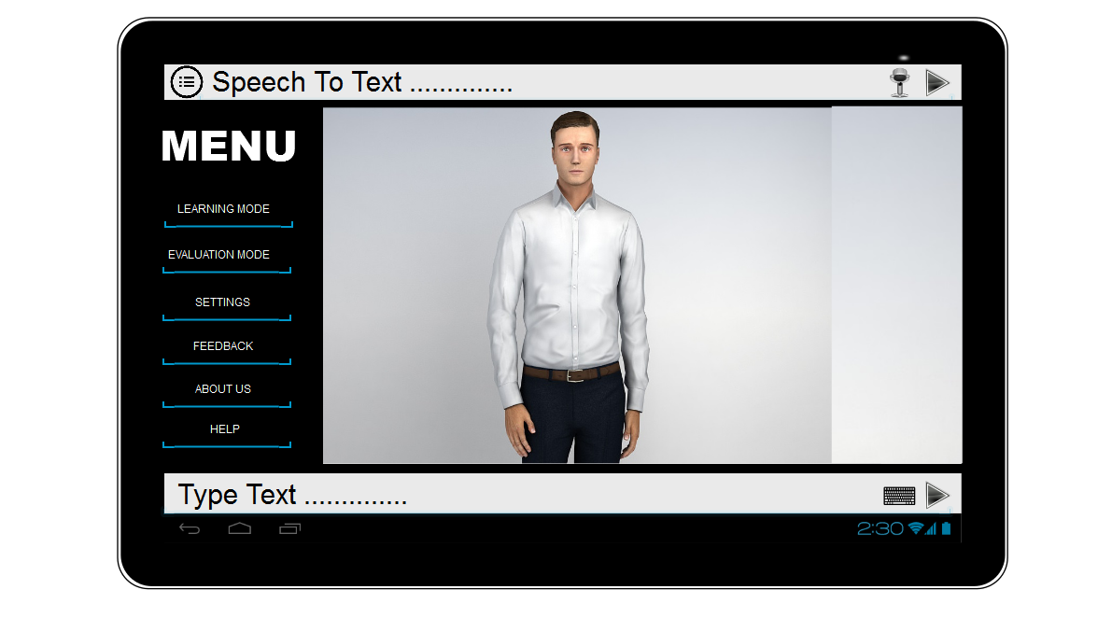
User Interfaces
Note: 1-2 Slides/Per Module
Insert all the user interfaces with proper caption as per each module.
For EXAMPLE:
Interface-1: Main Screen Of application

Slide 24
Conclusion
Note: 1 Slide only
Conclude your project SDS presentation.

Slide 25
References
Note: 1 Slide only
Mention the books, research papers, web links etc.
Insert references in this slide.
Use standard referencing style

Slide 26
Plaragism Report
Note: 1 Slide only
Attach the Plaragism report of your project SRS document from library staff of turnitin tool (http://turnitin.com)

Slide 27

Questions and Answers

